Slide 1
Enabling System Architect for BMM
Intent Review
Norman Kasser
24-Feb-2012
Revised: 06-Mar-2012
Revised: 28-Mar-2012

Slide 2
Enabling System Architect for BMM
Background
  “BMM” is “Business Motivation Model”
  BMM is a more elaborate implementation of the “Enterprise Direction” diagram already in SA.
  BMM assists a business in modeling where it wants to go and how it will get there.
  This implementation is based on the OMG publication “Business Motivation Model – Version 1.1” dated May 2010.
What is the problem we are solving?
  BMM currently exists as an unsupported add-on to SA. It will be uploaded to DevWorks for any client who want to use BMM with the about-to-be-released version of SA 11.4.1.2.
  This Intent is about fully integrating BMM into the succeeding version of SA 11.4.2.
  Any encyclopedia created with the DevWorks add-on should continue to work cleanly when opened with SA 11.4.2.

Slide 3
Intent
We can convert the BMM metamodel found in DevWorks into a new SA “property set” that will ship with the next version.
We will add a new check-box to SA’s “Encyclopedia Method Support” dialog.
The check-box will allow the user to enable BMM-related diagrams and properties for any encyclopedia.
The check-box will initially be presented “on” for an encyclopedia with no special framework specified, otherwise initially presented “off”.
The legacy “Enterprise Direction” diagram type will be shipped as “hidden” except for an encyclopedia with the TOGAF 9 framework enabled. Clients who want to continue using that diagram can re-enable it using the “Tool | Method Support” dialog’s “Advanced” feature.

Slide 4
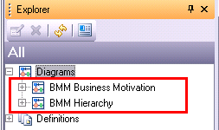
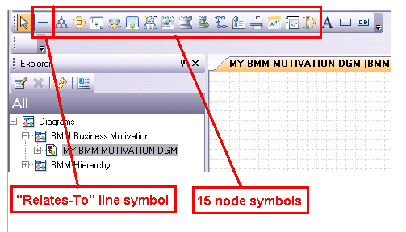
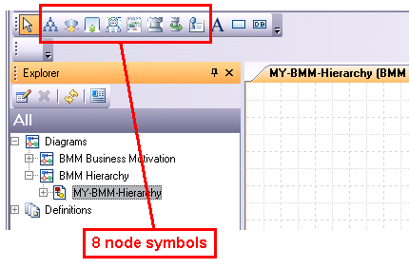
BMM Implementation
Two new diagram types

Slide 5
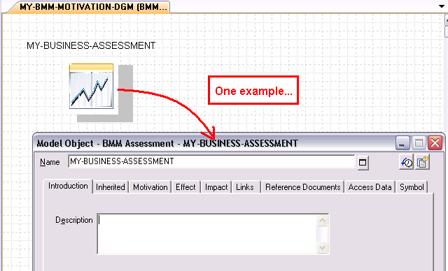
BMM Implementation
21 new definition types

Slide 6
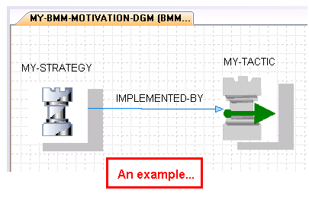
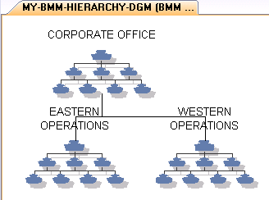
BMM Implementation
Line Symbols
Business Motivation Diagram
Just one line symbol
BMM Hierarchy Diagram
All parent-child lines are “built-in”

Slide 7
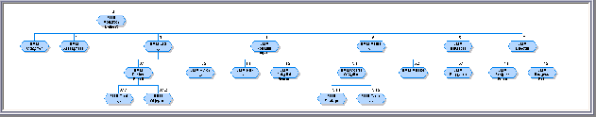
BMM Implementation
15 node symbols to support the Motivation Model
An overview of the BMM methodology
The diagram shows the various super and sub-types that make up the BMM methodology. This break-out is easier to read…
At the top: BMM Motivation Element
1. BMM Classifier 5. BMM Means
2. BMM Assessment 5.1 BMM Course Of Action
3. BMM End 5.1.1 BMM Strategy
3.1 BMM Desired Result 5.1.2 BMM Tactic
3.1.1 BMM Goal 5.2 BMM Mission
3.1.2 BMM Objective 6. BMM Influencer
3.2 BMM Vision 6.1 BMM Regulation
4. BMM Potential Impact 7. BMM Directive
4.1 BMM Risk 7.1 BMM Business Policy
4.2 BMM Potential Reward 7.2 BMM Business Rule

Slide 8
BMM Implementation
14 node symbols to support the Motivation Model
An overview of the BMM methodology
Of the 20 super and sub-types shown above, several super-types may easily be omitted from an SA diagram. A user may thus draw just the 13 basic node types highlighted below in red (plus one more that is useful).
At the top: BMM Motivation Element
1. BMM Classifier 5. BMM Means Plus one more that
2. BMM Assessment 5.1 BMM Course Of Action is useful:
3. BMM End 5.1.1 BMM Strategy Organization Unit
3.1 BMM Desired Result 5.1.2 BMM Tactic
3.1.1 BMM Goal 5.2 BMM Mission
3.1.2 BMM Objective 6. BMM Influencer
3.2 BMM Vision 6.1 BMM Regulation
4. BMM Potential Impact 7. BMM Directive
4.1 BMM Risk 7.1 BMM Business Policy
4.2 BMM Potential Reward 7.2 BMM Business Rule

Slide 9
BMM Implementation
Just one line symbol type to support the Motivation Model (1 of 4)
The one line symbol type on a Motivation Model is called “BMM relatesTo”. (That name is not very helpful.)
We really need 25 line symbols with type names as shown on the right.
That’s out of the question, since the SA toolbar would be rendered useless if we tried.
Luckily, there’s a nice alternative based built into SA’s “View | Display Mode” dialog (see next 3 slides).
BMM actsAs
BMM affectsAchievementOf
BMM affectsEmploymentOf
BMM amplifies
BMM channelsEffortsTowards
BMM classifies
BMM defines
BMM determines
BMM effectsEnforcementLevelOf
BMM establishes
BMM governs
BMM guides
BMM identifies
BMM implements
BMM isBasisFor
BMM isFormulatedBasedOn
BMM isJudgementOf
BMM isPlannedByMeansOf
BMM makes
BMM makesOperative
BMM providesImpetusFor
BMM quantifies
BMM realizes
BMM recognizes
BMM supportsAchievementOf

Slide 10
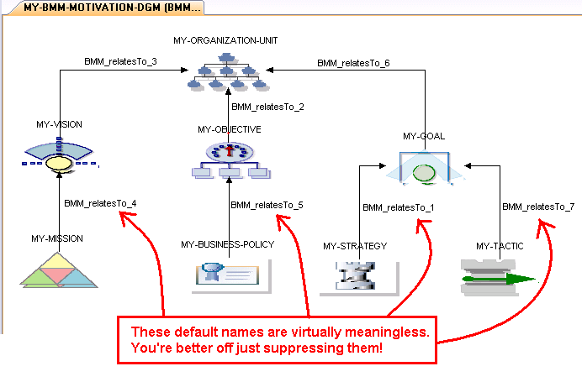
BMM Implementation
Just one line symbol type to support the Motivation Model (2 of 4)

Slide 11
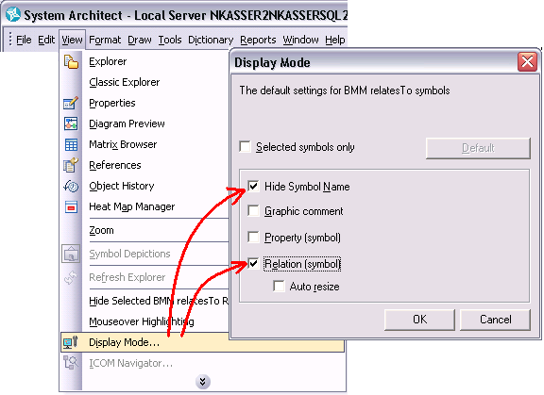
BMM Implementation
Just one line symbol type to support the Motivation Model (3 of 4)
Make use of this feature…
(Note that we will ship it as the default setting for BMM line symbols.)

Slide 12
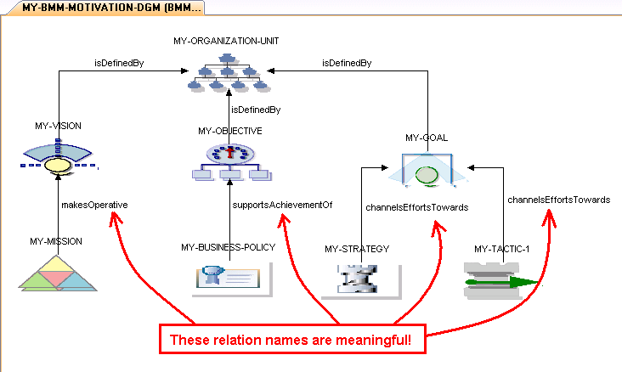
BMM Implementation
Just one line symbol type to support the Motivation Model (4 of 4)

Slide 13
BMM Implementation
8 node symbols to support the Hierarchy diagram
This is a typical hierarchy, where all symbols are the same type.
Other typical clusters are:
Hierarchies of Goals
Hierarchies of Objectives
Hierarchies of Strategies
Hierarchies of Tactics
Hierarchies of Organization Units
Hierarchies of Business Policies.
User will discover that they are in fact prevented from creating hierarchies not in the above list.*
*Two exceptions: For technical reasons, users are not prevented from creating a hierarchy of mixed Strategies and Tactics or mixed Goals and Objectives. However, they should not do so, since it would not follow BMM guidelines.

Slide 14
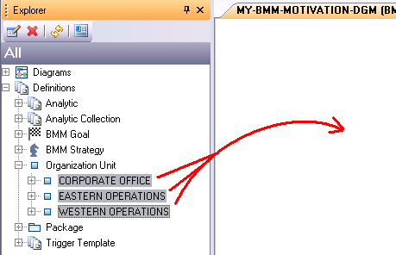
BMM Implementation
Interaction between the two diagram types – 1 of 3
What happens when
you drag a set of hierarchy-related definitions into a Motivation Model diagram?

Slide 15
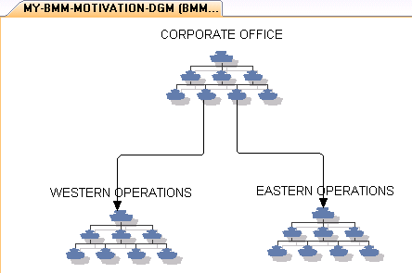
BMM Implementation
Interaction between the two diagram types – 2 of 3
You get the “relates-to” lines for free, reflecting the hierarchy.

Slide 16
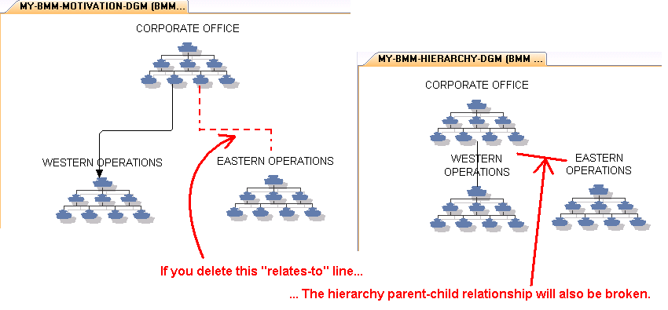
BMM Implementation
Interaction between the two diagram types – 3 of 3
It works the other way too!

Slide 17
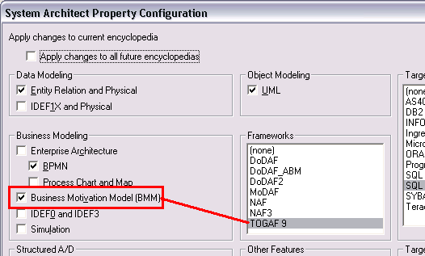
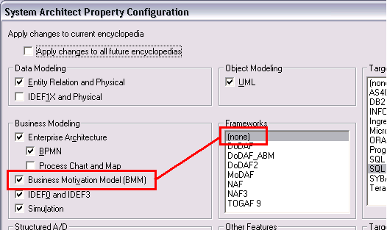
How to Enable BMM
Tools | Customize Method Support
BMM is enabled by default only when no framework is specified.
For other frameworks, the user can easily enable BMM manually.

Slide 18
Content
Looking ahead, here are some features that can be considered for future content:
Analytics
Browser views / Dynamic views
Document templates
Frameworks
Guidebooks
Macros
Matrices
Matrix views
Pre-defined Explorer object and Explorer relation reports
Pre-defined Focal Point integrations
Publisher templates
Reports

Slide 19
Open Issues, Q&A
1. "Addressability" It is not currently part of this version of BMM, but a user will be able to create A-addresses-B linkages by way of SA's implementation of OSLC. It is possible that user feedback may cause us to revisit this issue.
2. "Online Help" will be cloned from the existing help for "Enterprise Direction" with appropriate changes to the text. However, the text will also contain a link to the well-written OMG publication.
3. "TOGAF 9 (1)" When a user enables both BMM and TOGAF 9, there will be some overlap in properties. We may decide to create relationships when such overlap exists.
4. "TOGAF 9 (2)" When a user enables both BMM and TOGAF 9 in the same encyclopedia, it is possible that BMM will require some additional properties to make it fit better in a TOGAF 9 environment.
5. "Arrange as Hierarchy (1)" This is a subject for possible future enhancement. The existing BMM Hierarchy diagram is nice but allowing the user to rearrange his BMM Motivation Model diagram into a hierarchical form would be even better.
6. "Arrange as Hierarchy (2)" This is a subject for possible future enhancement. Assuming the above could be implemented, it would be made even better if just a selected set of symbols could be so arranged, leaving the rest of the BMM Motivation diagram as-is.
7. "Extra lines on a BMM Hierarchy diagram" This is a subject for possible future enhancement. Because it is a pure SA hierarchy diagram, all parent child lines are drawn automatically based on node placement, and no other line symbols are allowed. The BMM Hierarchy diagram would become more useful if the user could also draw standard BMM relation lines.

